Slide 1

Enterprise Inventory Intelligence
SmartShelfX: AI-Powered Inventory Management
Next-generation inventory optimization platform that transforms stock management through intelligent forecasting and automated restocking operations.

Slide 2

Platform Overview: Intelligence Meets Efficiency
The Challenge
Traditional inventory management struggles with stockouts, overstocking, and reactive ordering processes that drain resources and hurt customer satisfaction.
Our Solution
SmartShelfX leverages AI-powered demand forecasting to analyze historical sales patterns, seasonal trends, and real-time data, delivering proactive stock optimization with automated purchase order generation.

Slide 3




Core Platform Capabilities
Role-Based Access Control
Product Catalog Management
Secure JWT authentication supporting Admin, Warehouse Manager, and Vendor roles with tailored dashboards and permissions.
Comprehensive SKU tracking with vendor linking, reorder thresholds, category organization, and CSV batch import capabilities.
Transaction Tracking
Real-time stock-in and stock-out recording with timestamp logging, handler tracking, and automated inventory calculations.

Slide 4




AI-Powered Demand Forecasting Engine
Data Collection
Historical sales data, seasonal patterns, and real-time inventory levels aggregated from MySQL database.
ML Analysis
Python microservice using TensorFlow and Scikit-learn predicts future demand with daily and weekly forecasts.
Actionable Insights
Visual forecast trends with risk identification, highlighting products approaching stockout thresholds.
The AI engine continuously learns from new transaction data, improving prediction accuracy over time and adapting to changing market conditions and seasonal variations.

Slide 5


Automated Restock & Alert System
01
Smart Recommendations
AI identifies items requiring restock based on forecast models and current inventory levels.
02
Auto-Generated POs
System creates purchase orders with pre-filled vendor details, quantities, and delivery requirements.
03
Vendor Notification
Automated email and SMS alerts sent to vendors with order details and approval workflows.
04
Real-Time Alerts
Low stock, expiry warnings, and vendor response tracking keep teams informed and proactive.
Proactive Intelligence: SmartShelfX eliminates manual monitoring by automatically detecting inventory risks and initiating corrective actions before stockouts occur.

Slide 6





Technical Architecture & Technology Stack
Frontend Layer
React – Modern, responsive UI with intuitive dashboards and real-time data visualization
Backend Services
Spring Boot – Robust REST APIs handling authentication, transactions, and business logic with scalable architecture
Data Storage
MySQL with Hibernate ORM – Relational database managing users, products, transactions, and purchase orders with optimized queries
AI Engine
Python ML Service – TensorFlow and Scikit-learn models accessible via REST API for demand forecasting and predictive analytics
Analytics & Reporting
Chart.js – Interactive visualizations including trend analysis, comparison charts, and exportable Excel/PDF reports
Built for enterprise scale with secure JWT authentication, role-based access control, and comprehensive audit trails ensuring compliance and operational excellence.

Slide 7
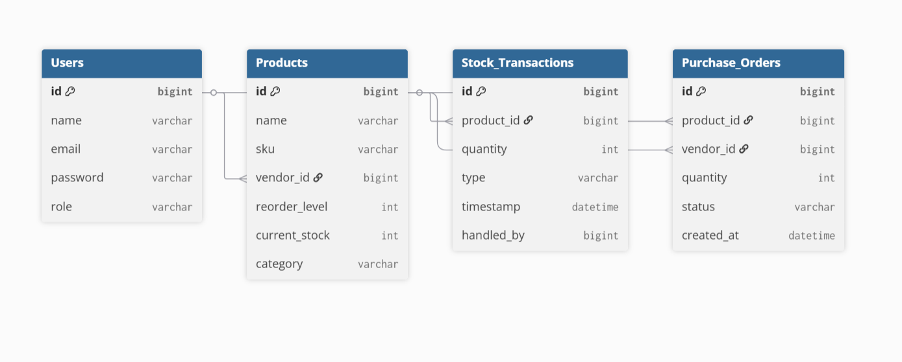
Database Schema

Slide 8

